Slide 1
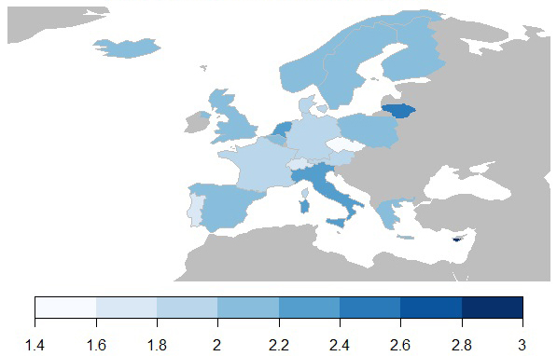
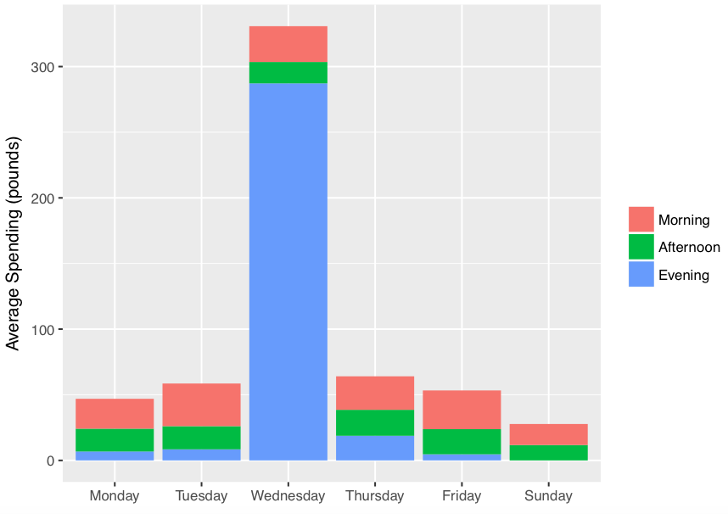
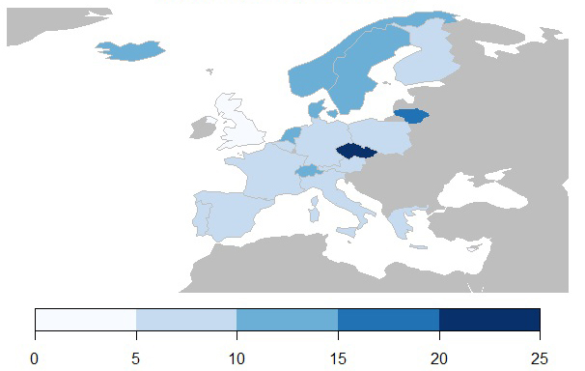
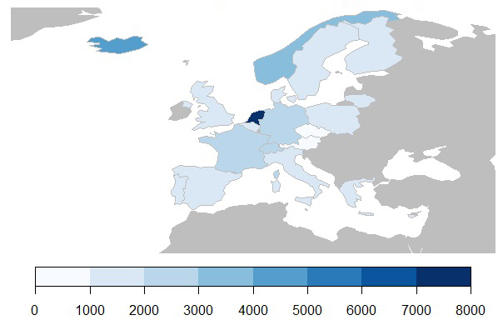
Analysis of Online Retail Consumption Patterns in Europe
Anthony Chan, Alexander Cho, Zhichuan Duan, & Devansh Kukreja
Instructor: Jerzy Wieczorek | Statistical Graphics and Visualization, Spring 2018 (36-315 A)
Data Description
Unit Price
Expenditure by Day and Time
The dataset contains transaction records for an anonymous UK-based online retail store which specializes in all-occasion gifts. Each row in the dataset is an item contained in a transaction which may contain multiple items. There are a total of 406,830 unique rows making up 22,190 unique transactions. Each row contains the transaction id, the unique item code, the item description, the quantity purchased, the invoice date, the unit price, the unique customer ID, and the country of that customer.
Figure 3 shows the median unit price of products purchased in each country. The Czech Republic and Portugal bring up the low end of our spectrum with a median price of £1.45 and £1.65 compared to the true median price of £2.09. Meanwhile, Cyprus and Malta both have median prices of £2.95 bringing up the upper end of the spectrum. The results would suggest that customers in the Czech Republic and Portugal tend to prefer cheaper gifts whereas customers in Cyprus and Malta prefer more expensive gifts.
Figure 6 presents the consumers’ average amount spent per transaction by day of the week and time of the day. Highest average is marked to be on Wednesday; particularly in the evening of the day. And the lowest is seen on Sunday with no spending pattern found in the evening. Thus, the results suggests that consumers tend to spend more in the middle of the week, and tend to spend less during the weekend.
…
Figure 3. Median Unit Price Per Country (pounds)
Figure 6. Average Expenditure by Day of the Week (pounds)
…
Quantity
Figure 4 looks at the average size of each order. In this case, the UK and Cyprus both bring up a very low 3 items per order and 4.5 items per order. Meanwhile, the Czech Republic orders on average 24 of each item per order. There are a couple different explanations for these results. Cyprus has a very low population relative to other countries in Europe so there might not be as much demand for gifts leading to suppliers buying less of each item. The UK may simply have more individual customers than organizational customers which would lower the average quantity.
…
Figure 4. Median Quantity Per Country
…
Expenditure by Country
Figure 5 displays the median total amount spent per transaction by the customers in each country. The Czech Republic has the lowest total amount spent per customer at just a little over £784 per transaction while Netherlands has the highest total amount spent per customer at £7138. It becomes apparent that the majority of the customers of this particular retailer are themselves whole-sale stores. Individual customers simply aren’t paying £7138 per transaction. Combined with the data from the previous graph, we are led to assume that while the Czech Republic buys a lot of gifts, the gifts they buy tend to be cheaper which matches the data from the first graph. While the Netherlands weren’t the highest unit price spenders or the highest quantity spenders, in both cases they were in the top percentiles and as such actually come out to be the highest total spenders.
Reference
Figure 5. Customer Total Spent Per Country (pounds)
Daqing Chen, Sai Liang Sain, and Kun Guo, Data mining for the online retail industry: A case study of RFM model-based customer segmentation using data mining, Journal of Database Marketing and Customer Strategy Management, Vol. 19, No. 3, pp. 197â€“208, 2012 (Published online before print: 27 August 2012. doi: 10.1057/dbm.2012.17).

